Slide 1
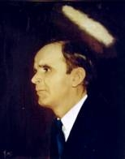

HE PAID A DEBT
He paid a debt He did not owe,
I owed a debt I could not pay,
I needed someone to wash my sin away;
And now I sing a brand new song,
Amazing grace all day long,
Christ Jesus paid a debt that I could never pay.

Slide 2
He paid a debt at Calvary,
He cleansed my soul and set me free
I'm glad that Jesus did all my sins erase;
I now can sing a brand new song ,
Amazing grace all along Christ Jesus
Paid a debt that I could never pay.

Slide 3
One day He's coming back for me
To live with Him eternally,
Won't it be glorious to see Him on that day;
I then will sing a brand new song
Amazing grace all along Christ Jesus
Paid a debt that I could never pay.

